Slide 1
Revision
Visual Basic

Slide 2
Table OF contents
L1 – Visual Basic Introduction
L2 – Data Types and Arrays
L3 – Object Properties and Methods
L4 – Algorithms Planning and Refinement
L5 – Procedures and Arguments (Part 1)
L6 – Procedures and Arguments (Part 2)
L7 – Decisions and Debugging
L8 – Looping Constructs and Iteration

Slide 3
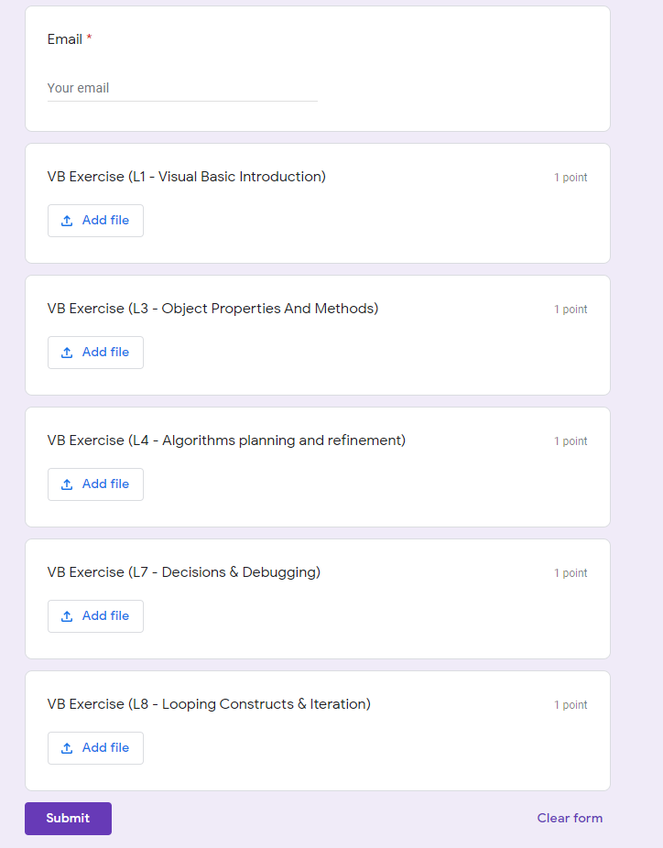
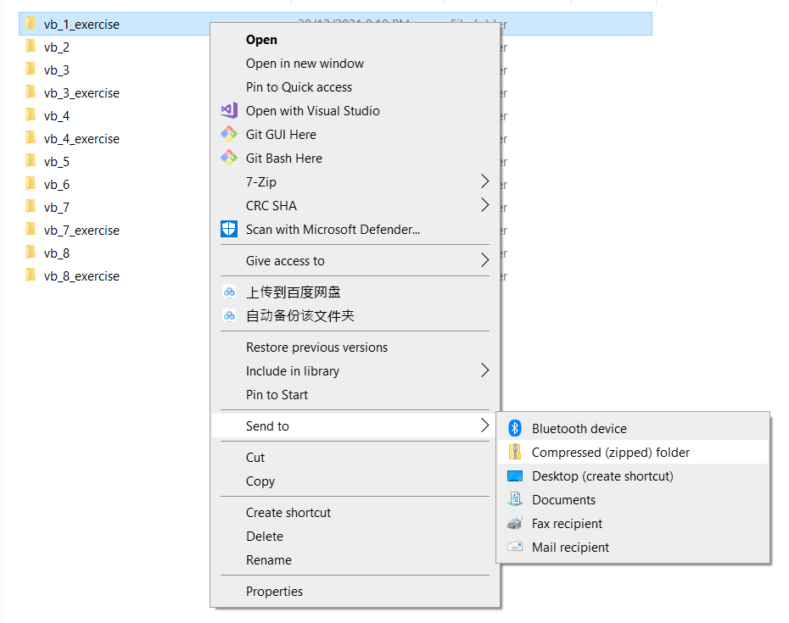

Exercise Submission
Submission Link : https://forms.gle/ZQFrNch4ihhN5aMz6
Zip the Project File
Submit the whole file to the google form

Slide 4
L1 – Visual Basic Introduction
Visual Basic

Slide 5
Table OF contents
Visual Studio IDE Components
Textbox
Button
Label

Slide 6
L2 – Data Types and Arrays
Visual Basic

Slide 7
Table OF contents
Numeric Data Types
Non-numeric Data Types
Array

Slide 8
L3 – Object Properties and Methods
Visual Basic

Slide 9
L4 – Algorithms Planning and Refinement
Visual Basic

Slide 10
L5 – Procedures and Arguments (Part 1)
Visual Basic

Slide 11
L6 – Procedures and Arguments (Part 2)
Visual Basic

Slide 12
L7 – Decisions and Debugging
Visual Basic

Slide 13
L8 – Looping Constructs and Iteration
Visual Basic

Slide 14

VB Test
35 minutes Open Book Test
MCQ and Coding Questions
Google Form
Time inclusive of opening the link and submission
Save your answer somewhere (Word, Notepad) so that in case the form is closed accidentally

Slide 15
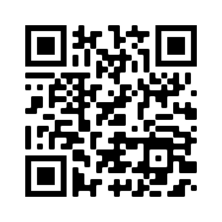
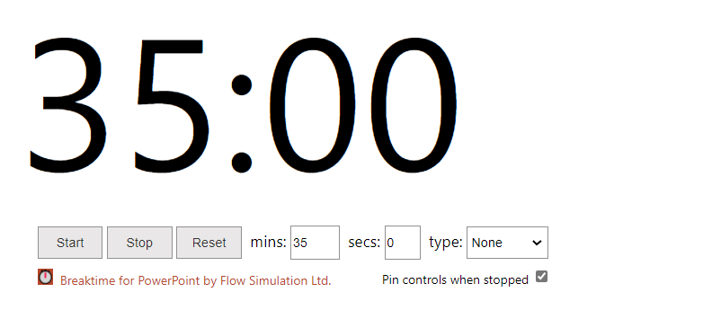
VB Test
Test Link: https://forms.gle/ZV81egTKYxCDSMxVA

